Slide 1

AGRICULTURAL PRODUCTION OF INDIA

Slide 2
Objective:-
The goal of this project is to solve the problems of various crops Cultivation or the Production in India.
Development of the reports and the Dashboards from which one can simply understand about the area, production and yield of different crops and their cultivation and production cost by the financial year in India and as well as in different states and also that one can understand which crop and its variety is suitable for their region.

Slide 3
Problem Statement:
The Agriculture business domain, as a vital part of the overall supply chain, is expected to highly evolve in the upcoming years via the developments, which are taking place on the side of the Future Internet. This paper presents a novel Business-to-Business collaboration platform from the agri-food sector perspective, which aims to facilitate the collaboration of numerous stakeholders belonging to associated business domains, in an effective and flexible manner.

Slide 4
Benefits:
Better understanding of cultivated area of India and its states.
Better understanding of Production and Yield of different Crops.
Better understanding of the Production and type of the Cultivation cost of different crops which also effect in deciding the MSP of crops in India.
Recommendation of the crops and its variety for the cultivation according to the Region.

Slide 5
Data Sharing Agreement :
Main File name (Agriculture Data)
No of files under main file (5)
Files Names under main file (Agriculture 1, Agriculture 2, Agriculture 3, Agriculture 4 and Produce)
Length of date stamp(8 digits)
Length of time stamp(6 digits)
Column names ( Crop, State, cost of cultivation, cost of production, area, production, yield, Financial year, Variety,
Column data type (Integer, Decimal, Date and String)

Slide 6
Data Description:-
Agricultural data contains mainly Area, production and yield and financial year of different crops and other columns as like cost, recommended zone and variety.
Crops: Different types of crops.
Production: Agricultural production is the use of crops and animal products to enhance human life sustainably.
Area: Crops are cultivated at this area.
4. Yield: It is also called Production per unit area.
5. Year of Financial year: Crops grown or produce in that specific time.
6. Cost of Cultivation (A2+FL): The A2 + FL cost includes all cash transactions and payments made by the farmer, including the cost of family labour It also includes the rental value of the leased land.

Slide 7
Cost of Cultivation (C2): C2 includes A2 + FL cost as well as the rent of owned land and interest on owned capital. Hence, the MSP calculated on the basis of C2 cost is much higher as compared to A2 + FL.
Cost of Production (C2): It is C2 type production cost.  Variety: It includes the variety of Crops.  Recommended zone: Suitable region for a better production for the crops

Slide 8
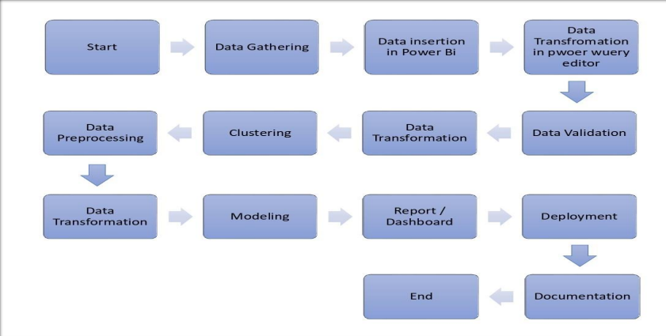
Architecture

Slide 9
Data Insertion in Microsoft Powe Bi:
All the files of Agricultural data was in csv format. So, after opening the Microsoft Power Bi, I have imported all the files in the Microsoft Power Bi.
Data was unstructured so I have transferred the data in Power Query Editor for the further process.

Slide 10
Data Validation and Data Transformation
First I have done some basic transformation of the data such as- removing error, removing null values, getting first row as header if required in the Power Query Editor.
The data was so messy so I have extracted the important data from the files and transformed it according to the requirement.
In the transformation process I have done different transformation such aspivoting and unpivoting columns, removing error, removing null values, creation of new tables.
Validation of date column:- I have validated the columns data type the most unstructured columns was date type data

Slide 11
Report and dashboard:
I have made some report and dashboard according to the requirement
Production and yield of Rice of Indian states by their cultivated area and financial year.
2. Production and yield of Wheat of Indian states by their cultivated area and financial year.
3. Production and yield of Coarse Cereals of Indian states by their cultivated area and financial year.
4. Cost of Cultivation and production of different crops and their Yields by their Area.
5. Production of Food Grains and Oilseeds of different Crops by their financial Year.
6. Comparison of Production of different Crops by their Financial year Crop recommendation for the Cultivation

Slide 12
Deployment:-
After making the Report and dashboards I have published it on the Microsoft Power Bi Service from Microsoft Power Bi Desktop

Slide 13
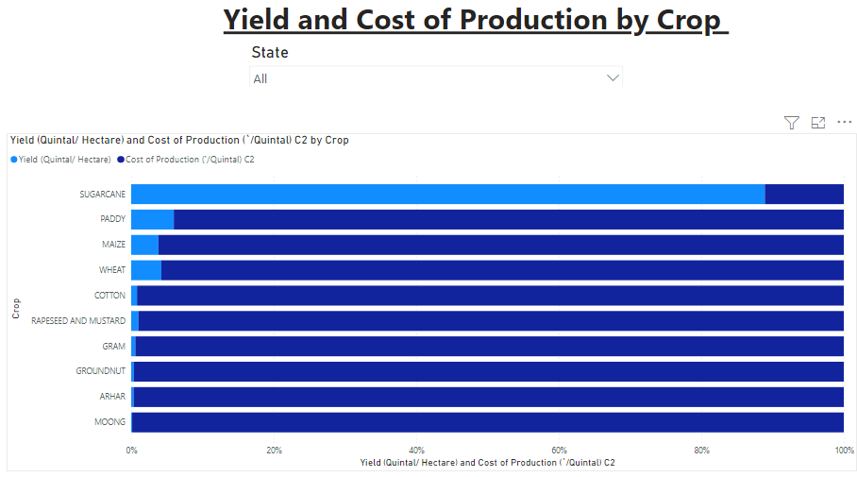
Insights:-
According to the analysis, I have made a few reports and dashboards.
Yield and cost of production by Crops

Slide 14
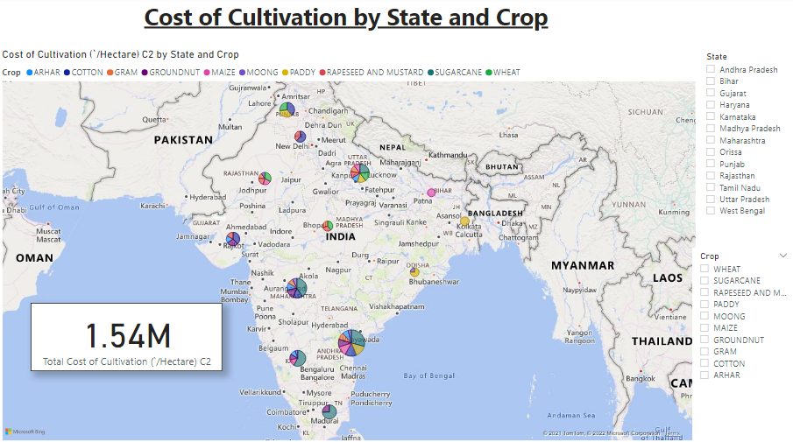

Slide 15
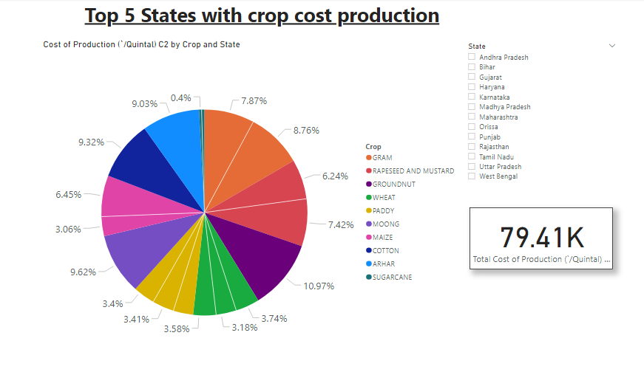

Slide 16
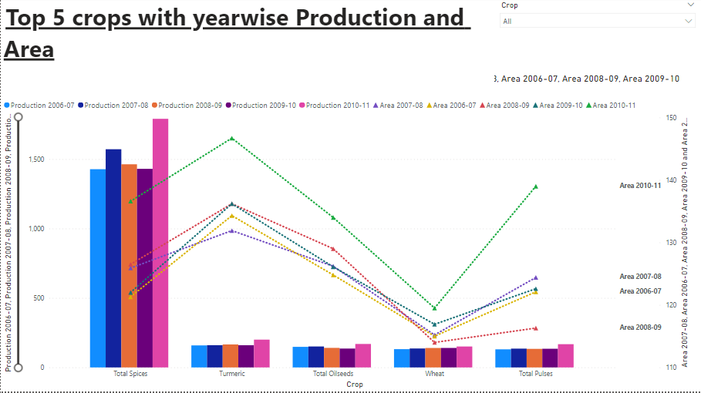

Slide 17
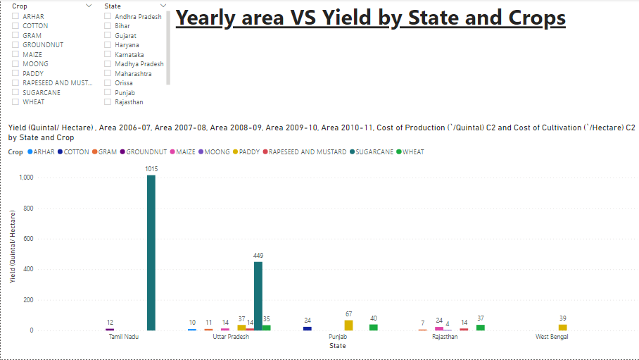

Slide 18
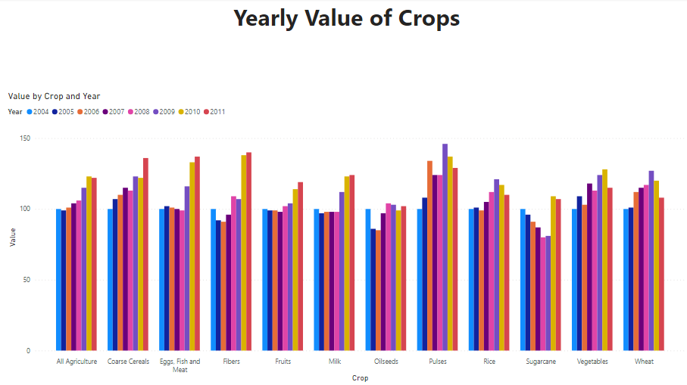

Slide 19
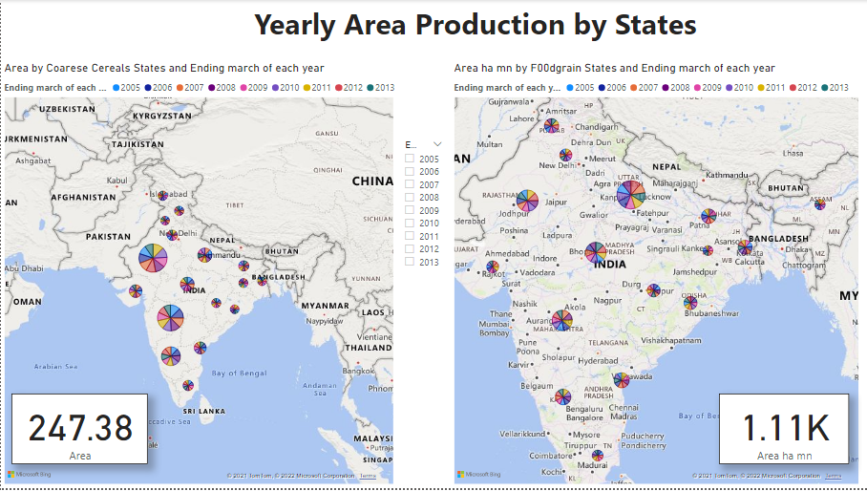

Slide 20
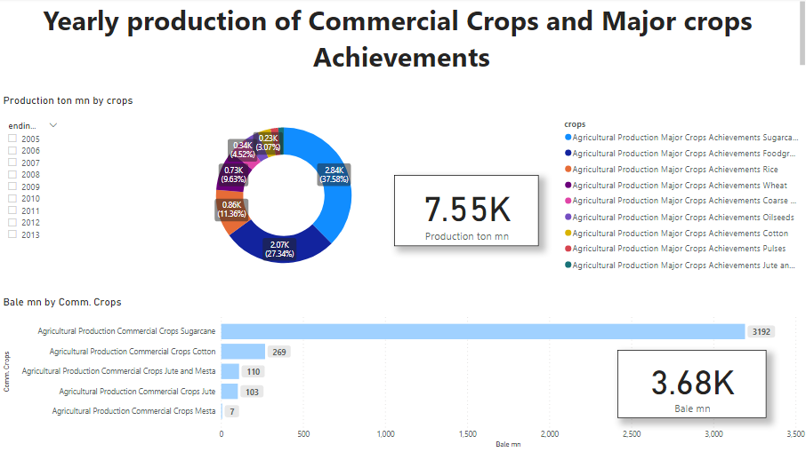

Slide 21
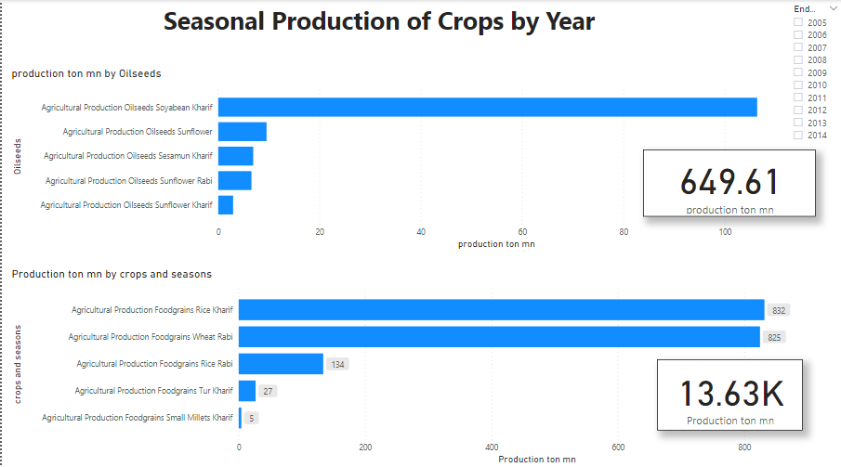

Slide 22
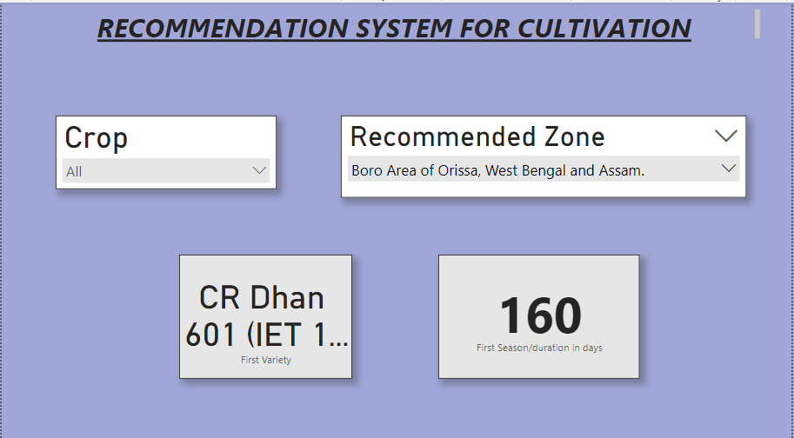

Slide 23
Q & A:
Q1) What’s the source of data?
The data is provided by the Ineuron in the format of google drive link.
Q 2) What was the type of data?
The data was the combination of numerical and Categorical values.
Q 3) What’s the complete flow you followed in this Project?
Refer slide 5th for better Understanding
Q 4) After the File validation what you do with incompatible file or files which didn’t pass the validation?
Files like these are moved to the Achieve Folder and a list of these files has been shared with the client and we removed the bad data folder.
Q 5) How logs are managed?
We are using different logs as per the steps that we follow in validation and modeling like File validation log , Data Insertion ,Model Training log , prediction log etc.

Slide 24
Q 6) What techniques were you using for data pre-processing?
✰ Removing unwanted attributes
✰ Visualizing relation of independent variables with each other and output variables
✰ Checking and changing Distribution of continuous values  Removing outliers
✰ Cleaning data and imputing if null values are present.  Converting categorical data into numeric values.  Scaling the data
Q 7) What are the different stages of deployment?
I have deployed it on the Microsoft Power Bi Service.

